Slide 1
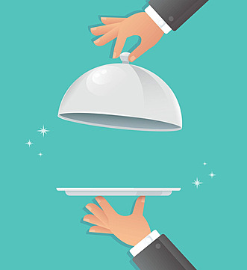
Customer Service
That Shows You Care
Notes:
Welcome to the Child and Adult Care Food Program( CACFP) Training. Currently, Food Services Division provides meals for 86 Early Education Sites. This training will prepare you and your staff for a successful and compliant year as you continue to provide nutritious meals to the Early Education children.
CACFP is a nutrition program that provides funding for healthy meals and snacks served to children in child care and other authorized facilities. This federally-funded program is operated by the United States Department of Agriculture (USDA), and in California is administered by the state Department of Education (CDE). CDE grants permission to sponsors (qualified, local nonprofit organizations or public entities) to directly oversee CACFP in family child care homes and child care centers that are eligible and qualified to participate in the program.
LAUSD Food Services Division is a sponsor that operates the CACFP. We receive payment for the meals prepared and served to eligible children who meet the age and income requirements. In order to receive the reimbursement, Food Services Division is responsible for ensuring that each of our established EEC is following the procedures as required by the USDA.

Slide 2
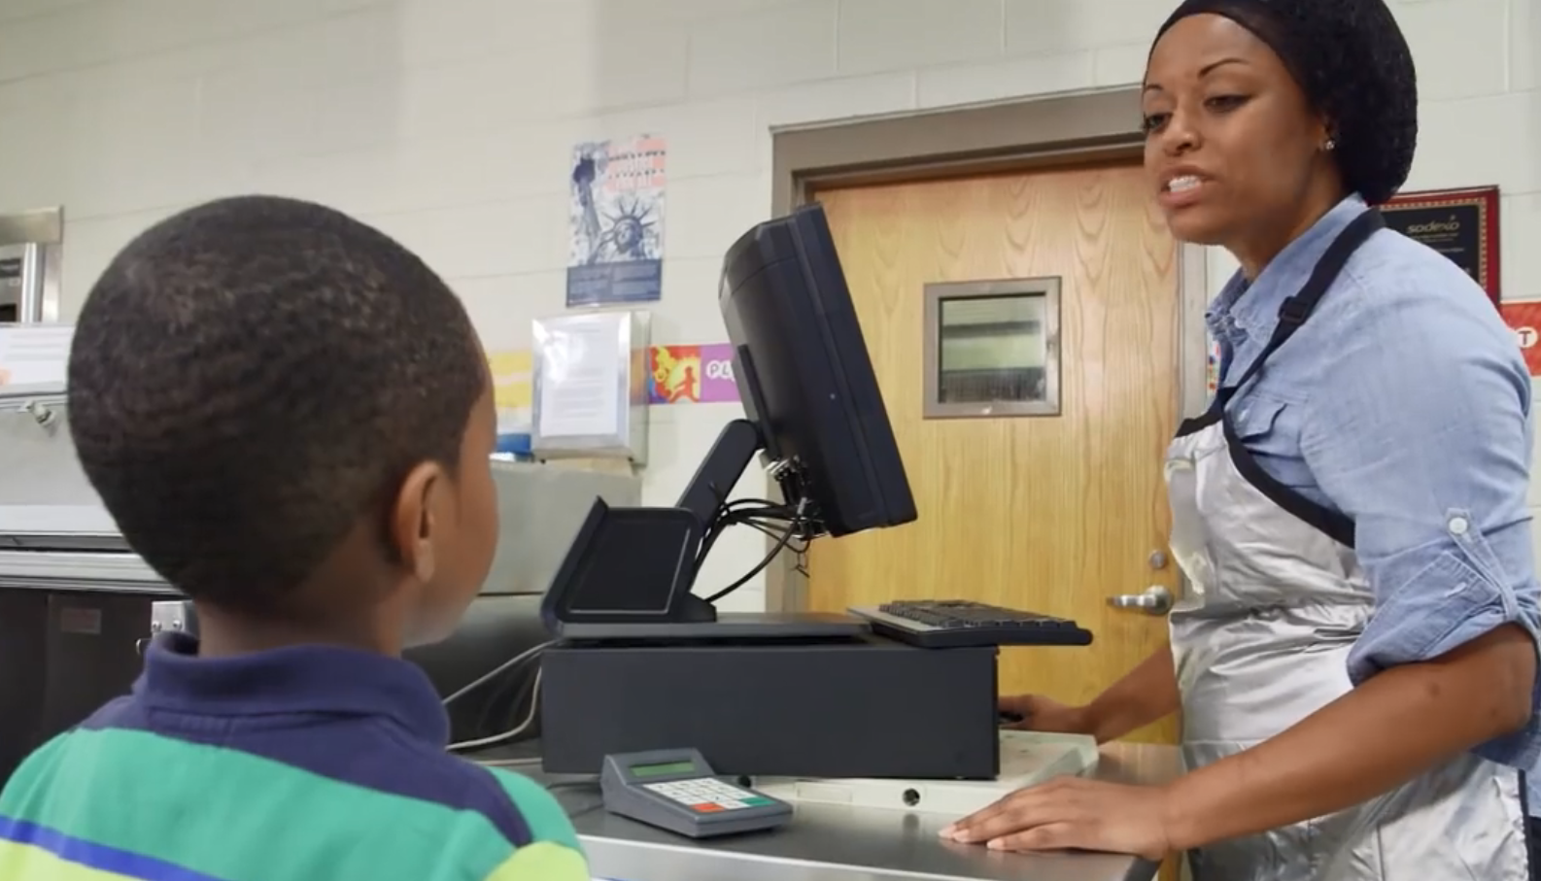
How We Treat The Students Matter!
Students are our primary customers. The way we interact with them not only has a lasting impact on the way they view our cafeterias, but it can also have an impact on their lives.

Slide 4
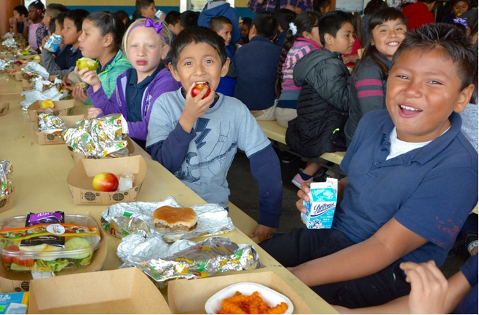
How do you treat the children that you serve?
Meal times are a break for the students from class.
It’s their time to eat, talk, and play.

Slide 5
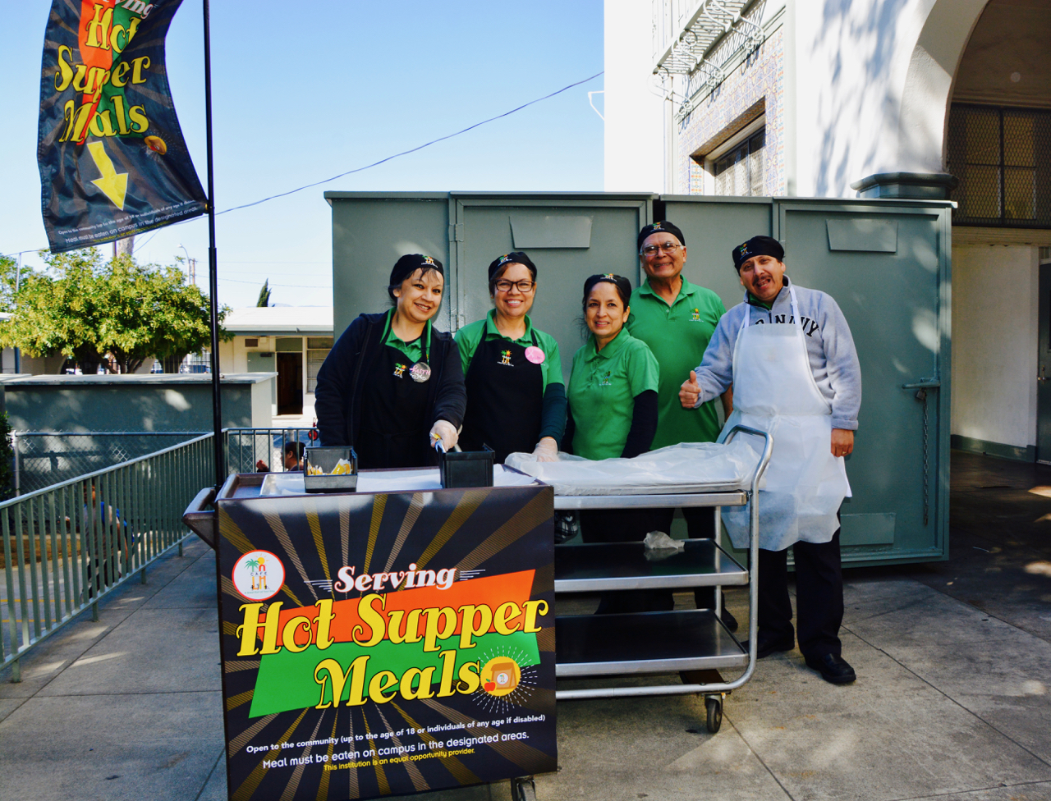
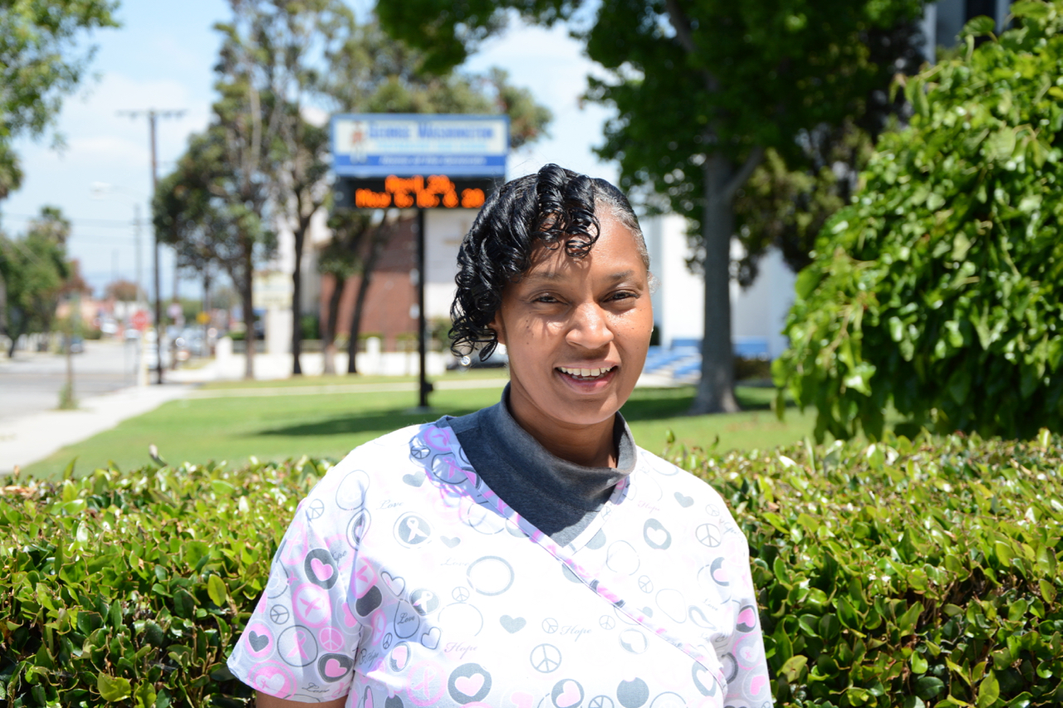
What Is Customer Service?
“The act of taking care of the customer's needs by providing and delivering professional, helpful, high quality service and assistance before, during, and after the customer's requirements are met.”
Good customer service is suitable and acceptable. Exceptional customer service creates a positive and memorable experience.

Slide 6
What Is Exceptional Service?
Exceptional customer service involves exceeding the customer’s expectations. This is accomplished when the standards and level of service received EXCEEDS what the customer could reasonably define as normal or expected.
Greet customers by name
Anticipate their needs
Keep favorites stocked
Knowing your menu
Welcoming atmosphere

Slide 7
Who Is An Internal Customer?
Someone who is a involved in your cafeteria operations whether on site or remote.
Co-Workers
Managers
Supervisors
Food Service Employees
An internal customer is any member of the group or organization who relies on assistance and information from another person to fulfill their job duties.
Co-Workers (Sub FSW, FSW, and Senior FSW)
Food Service Managers
Supervisors
Central Office Staff

Slide 8
Who Is An External Customer?
Someone who buys or inquires about your cafeteria’s offerings or services but is not a part of your operation.
Students
Parents
Teachers, Administrators, School Staff
District Employees Outside Food Service
Campus Visitors

Slide 9
What Is The CARES Approach?
The CARES approach was developed through the collaboration of Food Service Managers with the intent to focus on key areas during every the customer interaction.
Adhering to these simple principles will generate happy customers who will continue to visit your establishment.

Slide 10
C
A
R
E
S

Slide 11
Communication
When communicating to your customers:
Engage in conversation
Actively interact
Build a rapport
Ask, listen, and solicit feedback
Provide your full attention
Be mindful of body language
C

Slide 12
Appreciation
There is a basic human need to feel wanted, valued, and respected.
In order for your customers to know they are welcome and appreciated:
Greet and acknowledge your customers upon arrival
Make them feel important
Thank them for their business
Welcome them back
A

Slide 13
Respond
Our response time should be prompt and serve the needs of the customer by:
Addressing their needs quickly
Being attentive
Responding to their requests
Handling complaints in a timely manner
R

Slide 14
Expectation
Avoid mediocrity and exceed customer expectations by:
Being helpful
Relating to your customers
Remembering their likes and dislikes
Anticipating their needs
Providing quality service
E

Slide 15
Smile
A smile is a universally understood gesture that promotes positivity.
A smile will:
Welcome customers to your establishment
Be linked to kindness
Improve the mood
Make a good day great
S

Slide 16
Phone Based Customer Service
A phone call may be the only opportunity to interact with a customer and provide customer service.
Phone Etiquette
Answer the phone within the first 3 rings
Provide the following greeting, “Thank you for calling Café LA!”
Speak clearly and courteously
Smile as you’re speaking to the caller
All cafeteria team members should be aware of phone call etiquette procedures.

Slide 17
3 Types of Dissatisfied Customers
The
Goner
The
Gossiper
The
Complainer
Which type of dissatisfied customers would you prefer to deal with?

Slide 18
Goner
The Goner will not say anything to you or make a complaint:
Will not return to your establishment
Allowed you to acknowledge and make amends for your mistake

Slide 19
Gossiper
The Gossiper will bad talk about your establishment to their friends and family:
Loss in potential customers
Every customer can share their negative experience with three other potential customers, who in turn share with others
Your brand is now attached with a negative experience
Social media disgrace

Slide 20
Complainer
The Complainer will approach you in order to satisfy their expectations:
Provides voluntary feedback
Offers opportunity to turn a negative experience to a positive
If problem solved, will return as a customer
Will promote positive experience to others

Slide 21
3 Types of Dissatisfied Customers
The
Goner
The
Gossiper
The
Complainer
Now that we’ve discussed each type of dissatisfied customer, which one do you think is better for business?
The
Complainer

Slide 22
Handling Challenges
Customers may still be dissatisfied with the level of service received.
Thus, causing the customer to explode.

Slide 23
B.L.A.S.T Model
Let’s use the B.L.A.S.T model and learn how to diffuse the situation!

Slide 24
Believe
It is important to understand that your customer believes that your establishment has not met their needs.
Legitimacy of the complaint is irrelevant
Every person is different
Personal perception affects the perception of the service

Slide 25
Listen
To properly address a customer complaint, first identify the actual issue.
Listen attentively to the customers concern
Do not become defensive
Clarify your interpretation of the issue
These actions will provide the insight necessary to rectify the issue.

Slide 26
Apologize
A sincere apology shows the customers that you empathize with their concerns.
When you apologize you:
Take ownership of the issue
Comfort the customer
Show you care about their needs
Offering a sincere apology can diffuse the situation and eliminate any further frustration.

Slide 27
Satisfy
The customers’ perception of service is based on how the experience matches their expectations.
Find a solution
Give it your personal attention
Exceed their expectations

Slide 28
Thank
Thank your customers genuinely and sincerely for:
Bringing the situation to your attention
Caring enough to provide you with an opportunity to improve
Giving you a chance to correct it

Slide 29
Self-Assessment
How did I do today?
At the end of each workday, conduct a personal self-assessment of the service you provided throughout the workday.

Slide 30
Self-Assessment
Ask yourself:
Did I handle all situations professionally?
What challenges did I encounter?
Did I build relationships and trust?
How can I improve?

Slide 31
Self-Assessment
I’ll do better tomorrow!
Conducting a daily self-assessment will continuously guide you to develop your customer service skills.

